Slide 1

HEART DISEASE DETECTION USING MACHINE LEARNING
GUIDE:
Mrs.G.Julin Leeya, M.Tech.,
CSE Department
UCEA
BATCH MEMBERS:
Arunkumar R [513319104006]
Nithish Kumar B [513319104022]
Panneerselvam K [513319104025]
Surya A [513319104041]

Slide 2
ABSTRACT
We are using UCI[University of California Irvine] dataset with different test size and random state
We shall use Ada , Xgb and Stochastic Gradient algorithms
These algorithms will help to increase performance
To evaluate the performance of a classification model, different metrics are used, and some of them are as follows:
Accuracy : It can be calculated as the number of correct predictions to the total number of predictions.
Confusion Matrix:A confusion matrix is a tabular representation of prediction outcomes of any binary classifier, which is used to describe the performance of the classification model on a set of test data when true values are known.
Classification Report : A classification report is a performance evaluation metric in machine learning. It is used to show the precision, recall, F1 Score, and support of your trained classification model.

Slide 3
Architecture Design
user
Data requirements for prediction of heart disease
Pre-processing
Create model using different machine learning algorithms
Heart disease predictor’s result
Calculating result

Slide 4
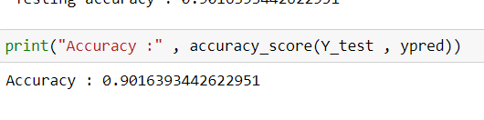
Results Obtained
1)Logistic Regression

Slide 5
References
Avinash Golande, Pavan Kumar T, Heart Disease Prediction Using Effective Machine Learning Techniques, International Journal of Recent Technology and Engineering, Vol 8, pp.944-950,2019.
T.Nagamani, S.Logeswari, B.Gomathy, Heart Disease Prediction using Data Mining with Mapreduce Algorithm, International Journal of Innovative Technology and Exploring Engineering (IJITEE) ISSN: 2278-3075, Volume-8 Issue-3, January 2019.
Fahd Saleh Alotaibi, Implementation of Machine Learning Model to Predict Heart Failure Disease, (IJACSA) International Journal of Advanced Computer Science and Applications, Vol. 10, No. 6, 2019.
Anjan Nikhil Repaka, Sai Deepak Ravikanti, Ramya G Franklin, Design And Implementation Heart Disease Prediction Using Naives Bayesian, International Conference on Trends in Electronics and Information(ICOEI 2019).
Theresa Princy R,J. Thomas,Human heart Disease Prediction System using Data Mining Techniques, International Conference on Circuit Power and Computing Technologies,Bangalore,2016.
Nagaraj M Lutimath,Chethan C,Basavaraj S Pol.,Prediction Of Heart Disease using Machine Learning, International journal Of Recent Technology and Engineering,8,(2S10), pp 474-477, 2019.
UCI, Heart Disease Data Set.[Online]. Available (Accessed on May 1 2020): https://www.kaggle.com/ronitf/heart-disease-uci
Sayali Ambekar, Rashmi Phalnikar,Disease Risk Prediction by Using Convolutional Neural Network,2018 Fourth International Conference on Computing Communication Control and Automation.
C. B. Rjeily, G. Badr, E. Hassani, A. H., and E. Andres, Medical Data Mining for Heart Diseases and the Future of Sequential Mining in Medical Field, in Machine Learning Paradigms, 2019, pp. 7199.
Jafar Alzubi, Anand Nayyar, Akshi Kumar. "Machine Learning from Theory to Algorithms: An Overview", Journal of Physics: Conference Series, 2018

Slide 6
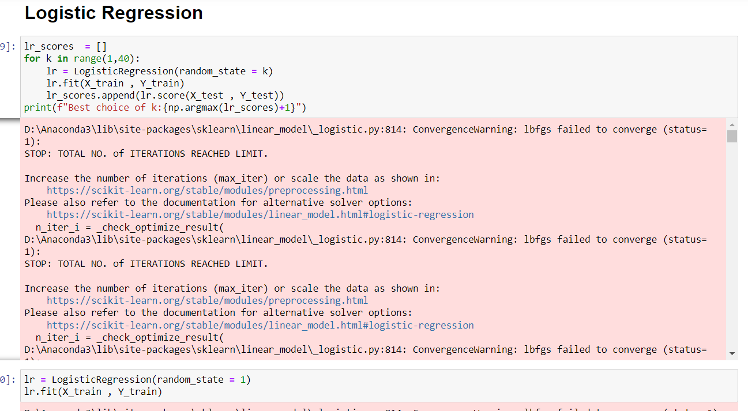
Code implementation

Slide 7
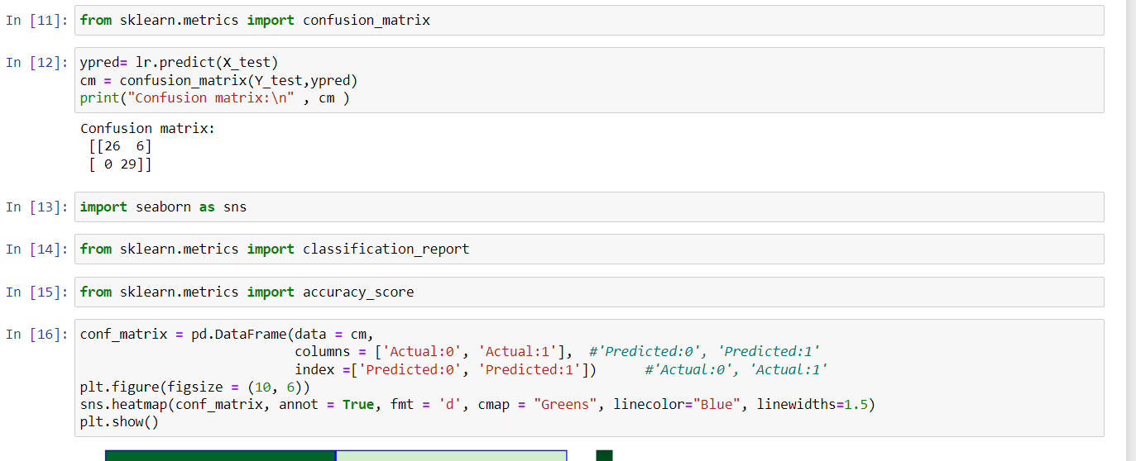
CODE IMPLEMENTATION

Slide 8
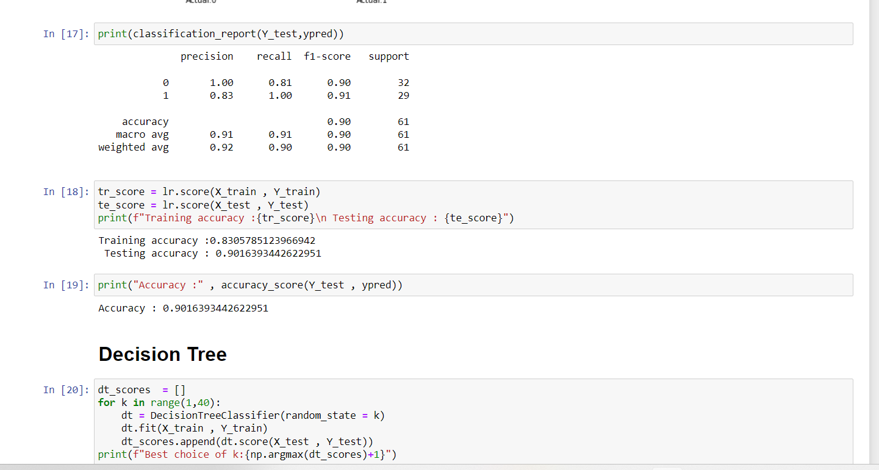
CODE IMPLEMENTATION

Slide 9
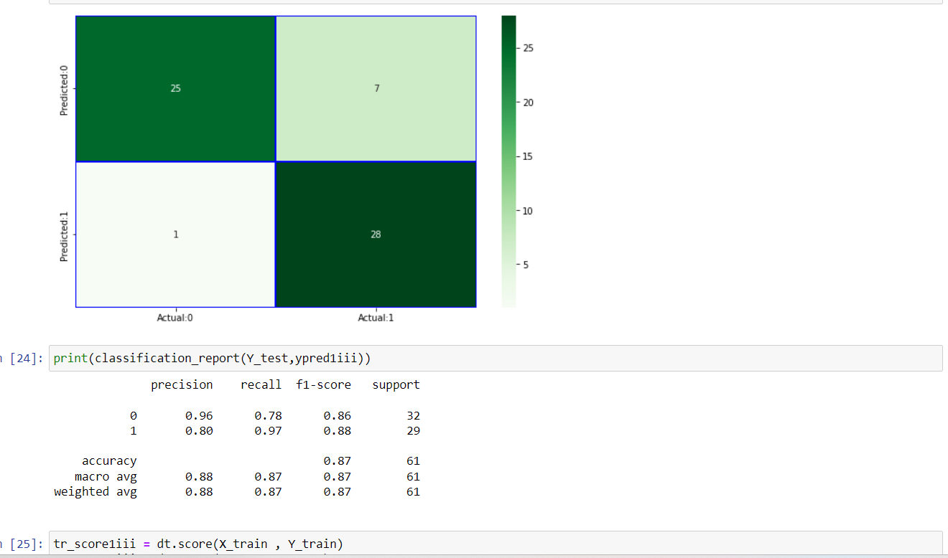
Code implementation

Slide 10
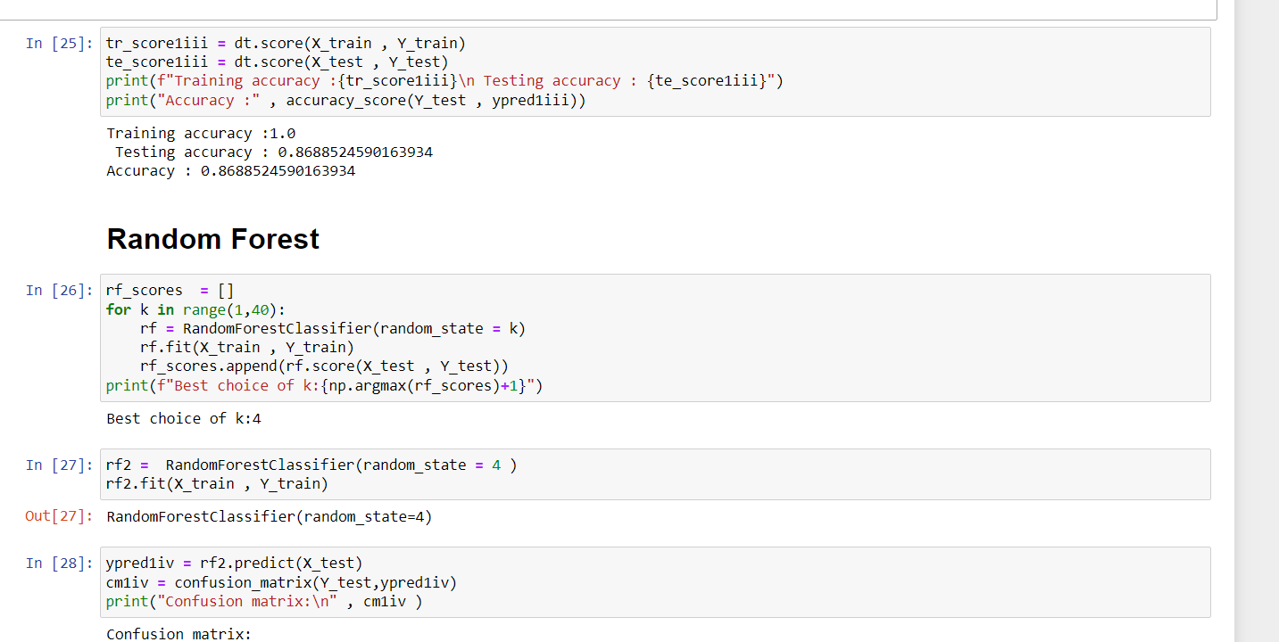
Code implementation

Slide 11
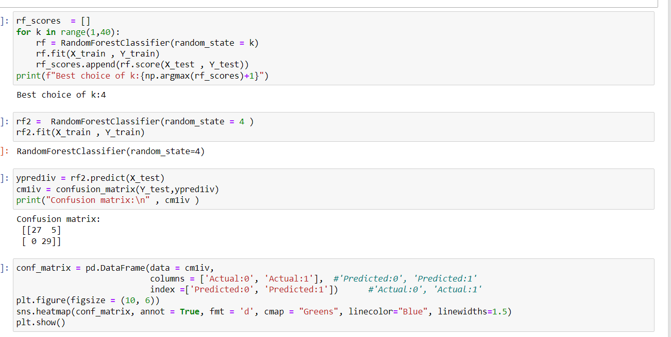
Code implementation

Slide 12
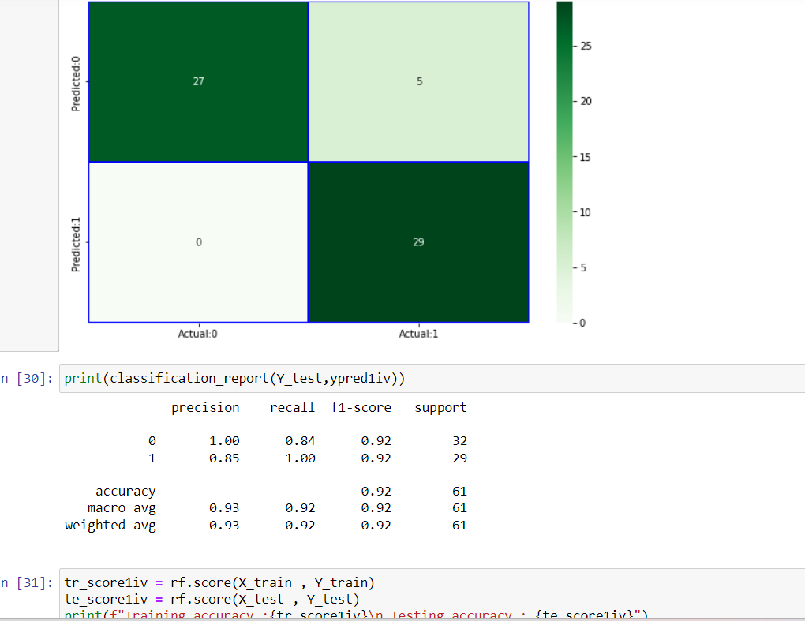
Code implementation

Slide 13
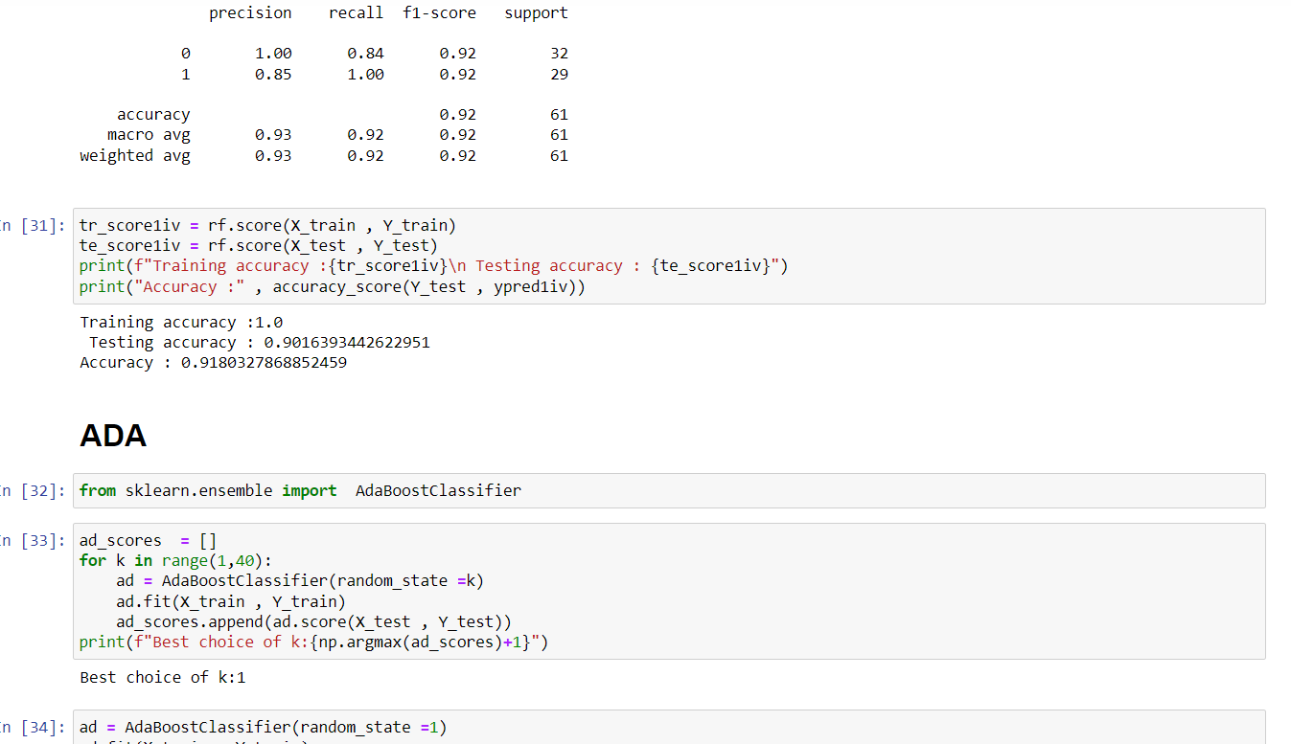
Code implementation

Slide 14
THANK YOU

